Slide 1
Lifestyle Changes Better Indicator of Chronic Disease
Rachel Khoo
Thinkful Capstone 3
October 2020

Slide 2
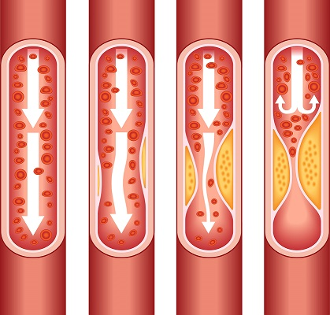
Many chronic disease can be prevented
Heart disease is the highest killer in the US
Blood pressure medications
Cholesterol screenings
Physical Activity
Notes:
About two-thirds get chol screen
Only about 50% of people who would benefit from bp meds are on them
50% of Americans don’t get enough exercise

Slide 3
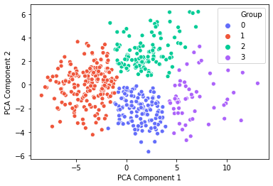
Who needs to be targeted for prevention?
Kmeans clusters health data into four groups
Health Outcomes
Prevention Measures
Behavioral Risk Factors
Notes:
Data is from the 500 cities project from the CDC

Slide 4
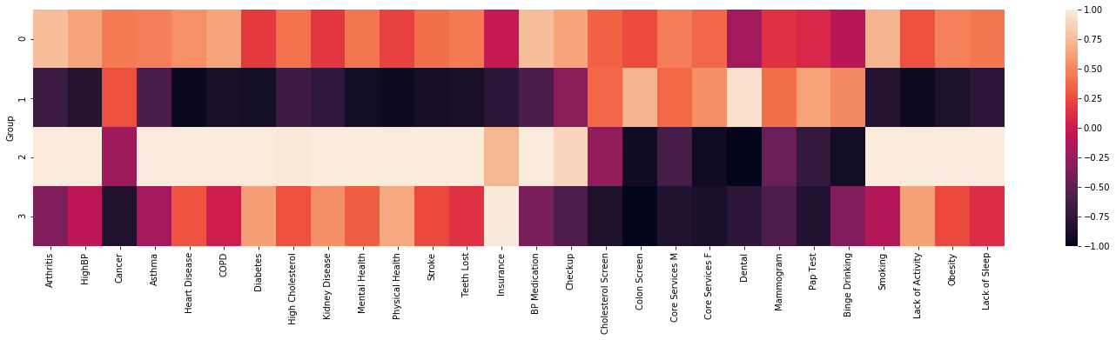
Who needs to be targeted for prevention?
Heath Outcomes
Prevention Measures
Habits

Slide 5
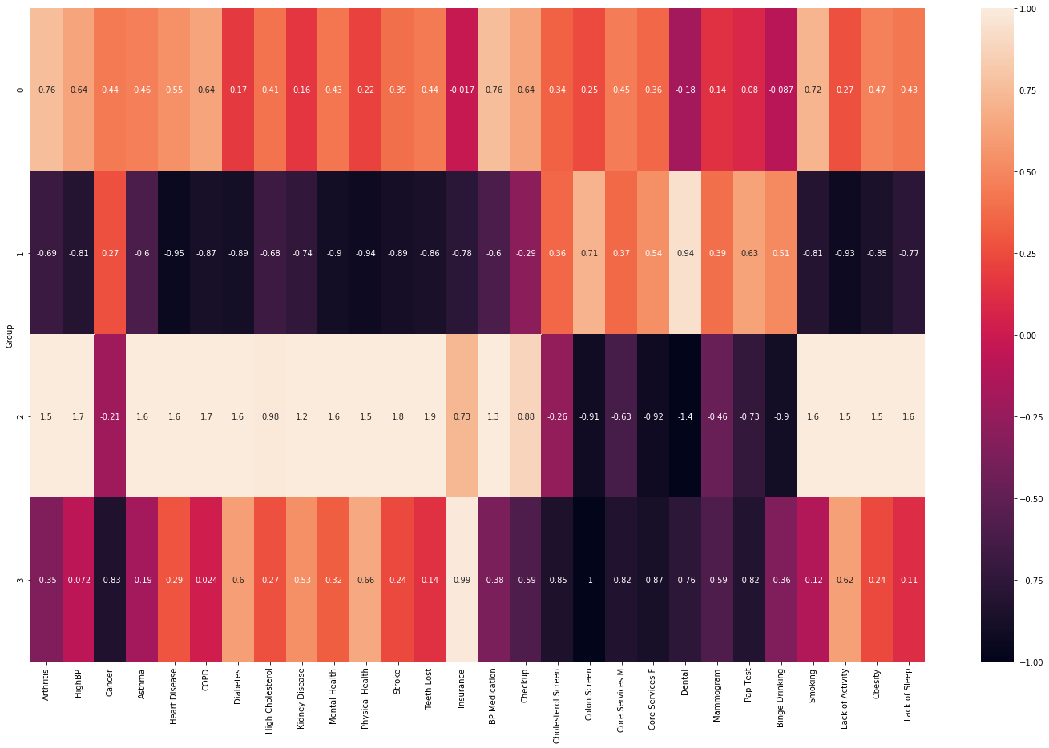
Group 0 – Catch-all
Heath Outcomes
Prevention Measures
Habits

Slide 6
Group 1 – Healthy
Heath Outcomes
Prevention Measures
Habits

Slide 7
Group 2 – Unhealthy
Heath Outcomes
Prevention Measures
Habits

Slide 8
Group 3 – Uninsured
Heath Outcomes
Prevention Measures
Habits

Slide 9
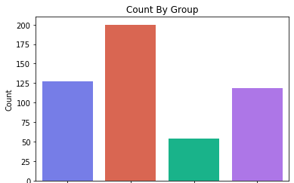
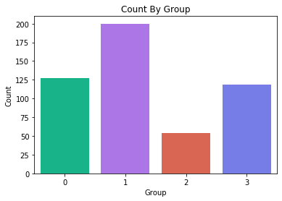
Healthy Group Dominates
Catch-all Healthy Unhealthy Uninsured

Slide 10
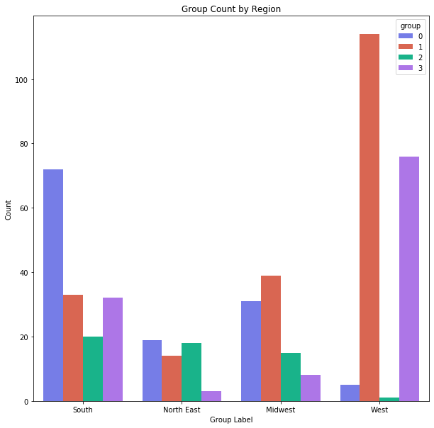

Slide 11

Catch-all
Healthy
Unhealthy
Uninsured

Slide 12

Catch-all
Healthy
Unhealthy
Uninsured

Slide 13

Catch-all
Healthy
Unhealthy
Uninsured

Slide 14

Catch-all
Healthy
Unhealthy
Uninsured

Slide 15

Catch-all
Healthy
Unhealthy
Uninsured

Slide 16
Prevention isn’t the most effective strategy
Lack of access to healthcare
Poor lifestyle choices

Slide 17
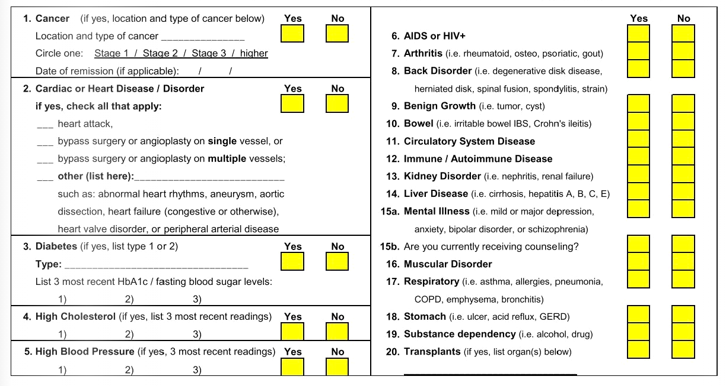
How do we lower rates of heart disease?
Focus on lifestyle changes
Medications and screenings
Incorporate into insurance

Slide 18
Further research could refine these groups
Gender information
Age ranges
More cities surveyed

